Slide 1


A General-Purpose Early Warning System for Undesirable Events during Outpatient Treatment for Cancer
Naihe Xiao

Slide 2
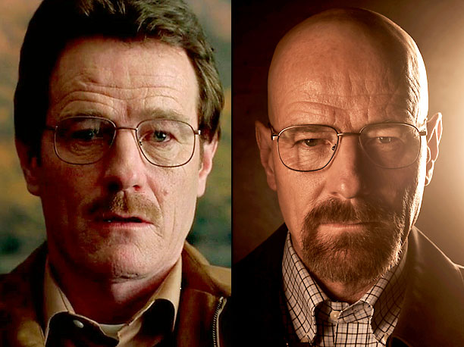
Introduction
Cancer is a leading cause of death
Treatments lead to undesirable cancer events(UCEs)

Slide 3
Introduction
Lung Cancer is a leading cause of death
Treatments lead to undesirable cancer events(UCEs)
Difficult and costly for clinical staffs to judge and monitor UCEs (Wang, Molassiotis, et al. 2018)
Early warning system that alerts possible UCEs is highly desirable

Slide 4
Aims
Build a model to predict labels for 10 binary UCEs
-Nausea -Appetite -Pain
-Dyspnea(Shortness of breath) -Fatigue(tiredness) -Anxiety
-Drowsiness(sleepiness) -Depression -Well-being
-ECOG: Functional status performance score.
Improve the clinic interpretability of the model

Slide 5
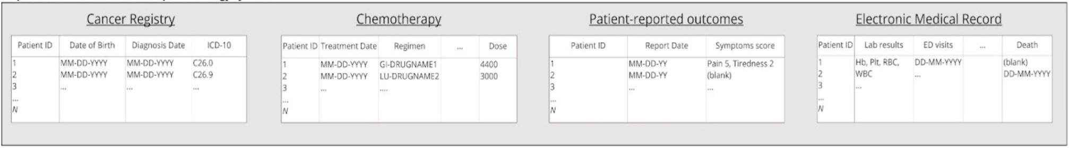
Data
Patients undergoing cancer treatments at the PMCC
Data processing:
(i) Gathered and merged raw data from multi sources
(ii) Feature engineering: 5-day forward filling, mean imputation,
normalization
(iii) Data inspection(varying data volume and distribution)

Slide 6
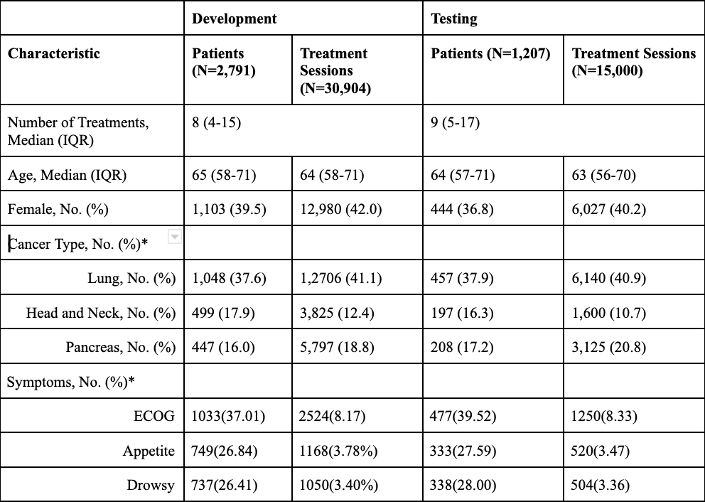
Study Cohort

Slide 7
Measurements of Targets Correlation
1. Time Lagged Cross Correlation (TLCC):
Method: Measures correlation between two time series at different time lags.
Pros: Captures time-delayed relationships
Cons: Hard to interpret, too few visits for each patient

Slide 8
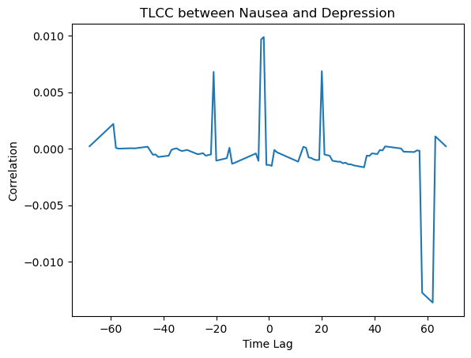
Outcome: TLCC between Nause and Depression
y = Correlation between overlapped
time points of the two time series when
each time point of the former time series increases by x
Inconsistent outcomes, hard to
interpret

Slide 9
Measurements of Targets Correlation
1. Time Lagged Cross Correlation (TLCC):
Method: Measures correlation between two time series at different time lags
Pros: Captures time-delayed relationships
Cons: Hard to interpret, too few visits for each patient
2. Repeated Measures Correlation (RMCORR):
Method: Assesses correlation within the same subject across multiple measurements over time.
Pros: Accounts for individual subject differences
Cons: Susceptible to influence from outlier subjects

Slide 10
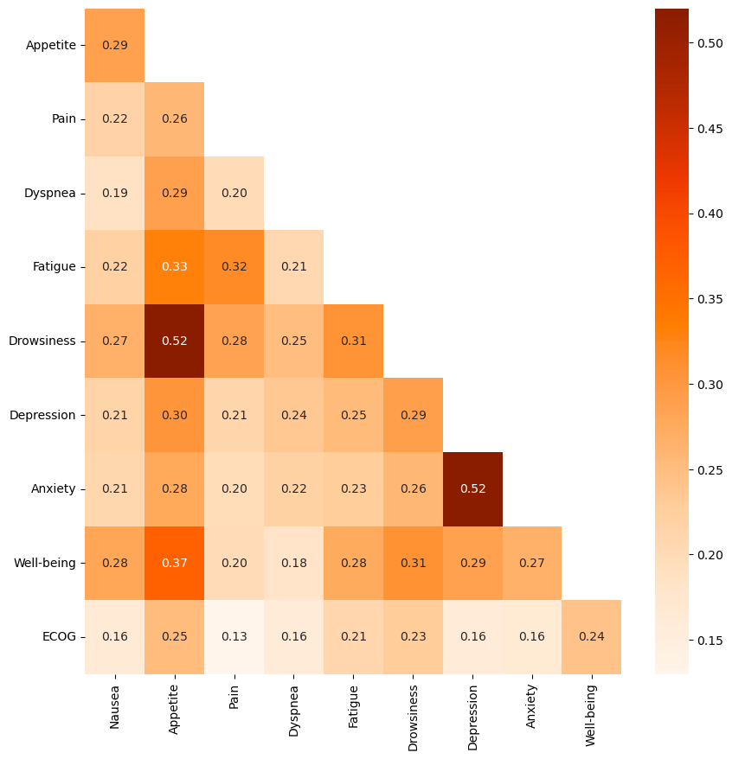
Outcome: RMCORR for 10 UCEs

Slide 11
Model Building

Slide 12
MTL vs STL
Single Task Learning Multi Task Learning
Each target treated as an independent task
10 targets,10 models, 10 loss functions, weights updated independently
Multiple related tasks learned jointly using a single model
10 targets,1 model, 1 loss function, weights updated simultaneously

Slide 13
MTL vs STL
Single Task Learning Multi Task Learning
Simple design
Computational Intensive
Ignores target dependencies
Increased model complextiy
Efficient Training
Captures shared information and knowledge

Slide 14
MTL vs STL
“The improvement in MTL happens because if tasks are related, features that are learned for one task might benefit the learning of some other related task.” --- Gabriele, Michael, 2020, “Learning Functions to Study the Benefit of Multitask Learning”

Slide 15
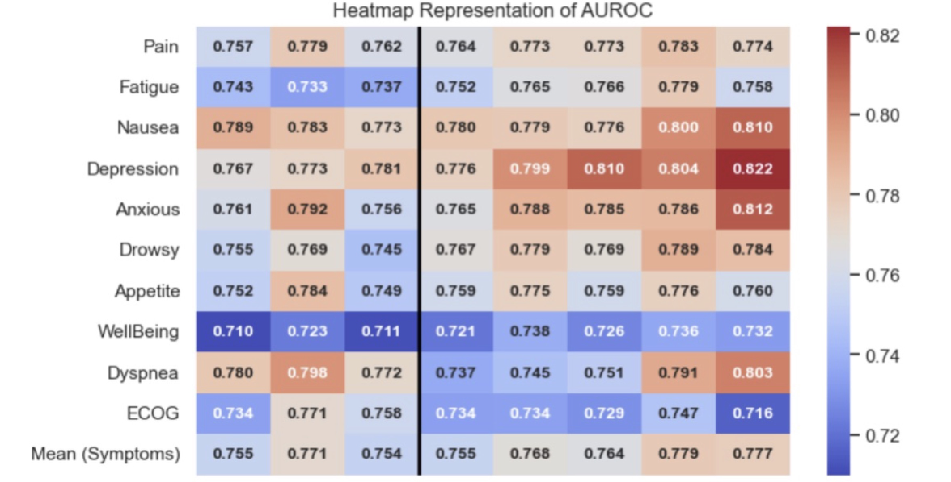
STL models
MTL models

Slide 16
Model Interpretation

Slide 17
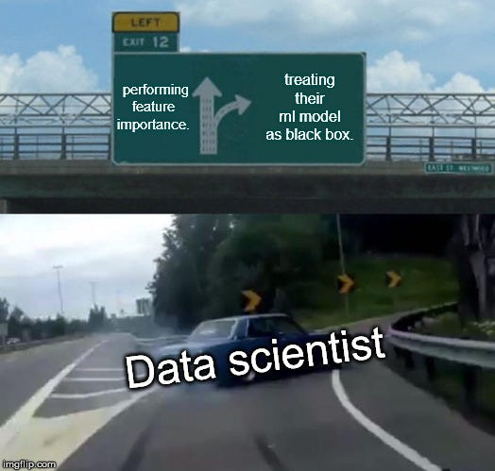
Feature Importance: how much does this feature contribute to the overall outcome of a model

Slide 18
SHAP Values
Assign an importance value to each feature.
Positive SHAP - improve model performance; visa versa
Pros:
Consistent - model invariance
Capture feature dependencies
Cons:
Computationally intensive
Hard to interpret

Slide 19
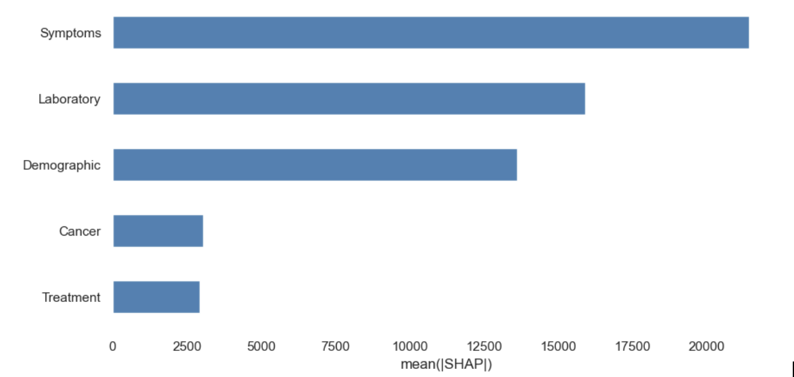
Outcome by groups

Slide 20
Permutation importance
Computes the change in evaluation metric when the values of a specific feature are randomly permuted.
More the metric changes, more important the feature.
Pros:
Fast computation - no re-training
Applicable to all model types
Cons:
Ignore feature dependencies
Outcome vary on metrics

Slide 21
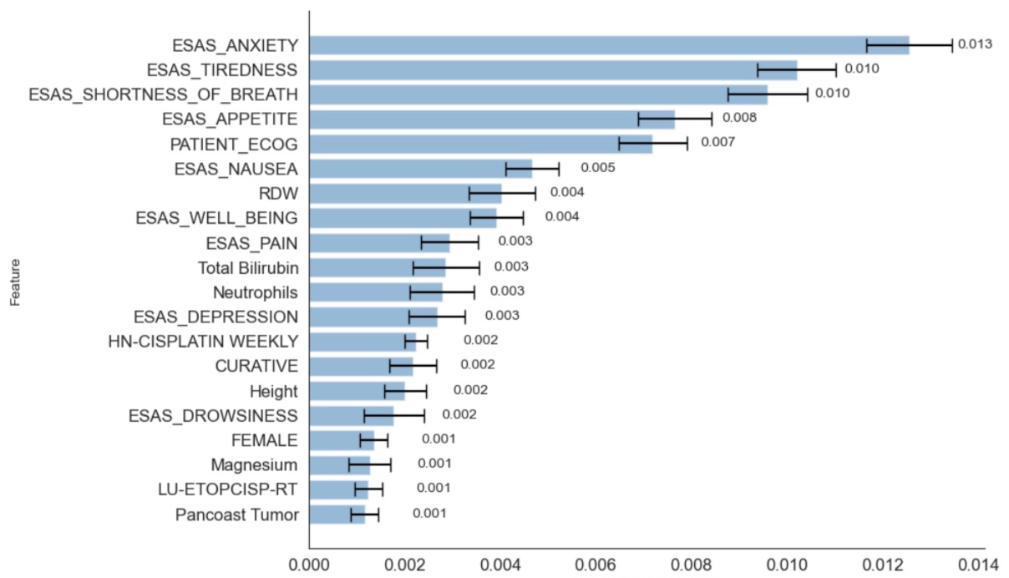
Average change in AUROC over all targets

Slide 22
Conclusions
Longitudinal machine learning predicts diverse symptoms accurately.
Multi-Task Learning (MTL) outperforms Single-Task Learning (STL) in correlated targets.

Slide 23
Future Works:
1. Data Augmentation & quality improvement
2. Implementation of the early warning system

Slide 24
Thank you for listening
Appreciate the help and guidance of Geoffrey Liu, Robert Grant, Noke Yuan, Christopher Deutschman, Rami Ajaj

